Slide 1

Crime Data Analysis and Visualization for Los Angeles (2020-Present)
Jitesh Makan
Bryan Carney
SVETLANA KACHINA

Slide 2
Overview: Analysis of crime trends and patterns in Los Angeles from 2020 to Present. Understanding spatial and temporal crime distributions for improved public safety.
Objectives:
Explore crime rates by type and location, and other factors.
Identify most frequent crimes occurring along with its related solved rates.
Highlight crime hotspots through interactive visualizations.

Slide 3







Methodology & Technical Approach
Backend Processing:
Python/D3 : Data processing, analysis routines, and AWS development. Psycopg2 to create table and import directly into PosgreSQL.
PostgreSQL: Efficient storage and querying of large datasets.
Frontend Visualization:
JavaScript: Dynamic UI components (dropdowns, filters).
Plotly/LeafLet: Rendering interactive charts and heat maps.
Workflow Summary:
Data acquisition → Cleaning & processing → Analysis → Visualization.

Slide 4
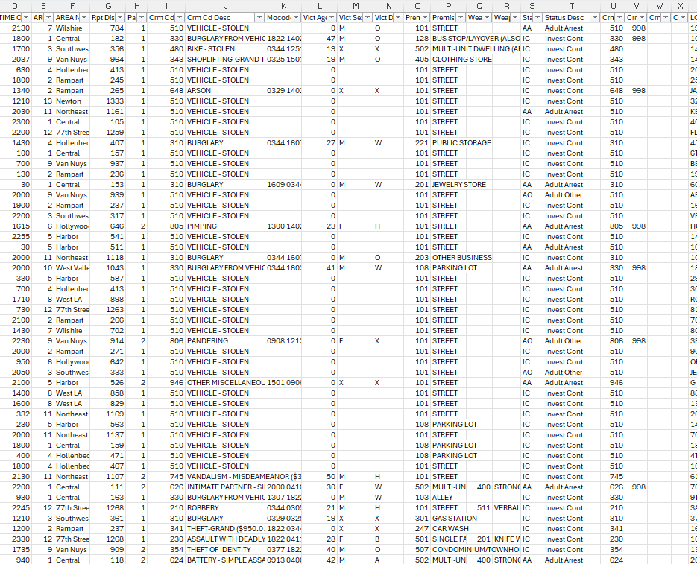
Data Overview
Data Source:
Publicly available “Crime Data from 2020-Present” (U.S. Government open data portal).
Key Data Attributes:
Crime type, location, crime solved rate, usage of the weapons if any.
Detailed records enabling both spatial and temporal analysis.
Data Preparation:
Data cleaning, validation, and import into a PostgreSQL database.

Slide 5
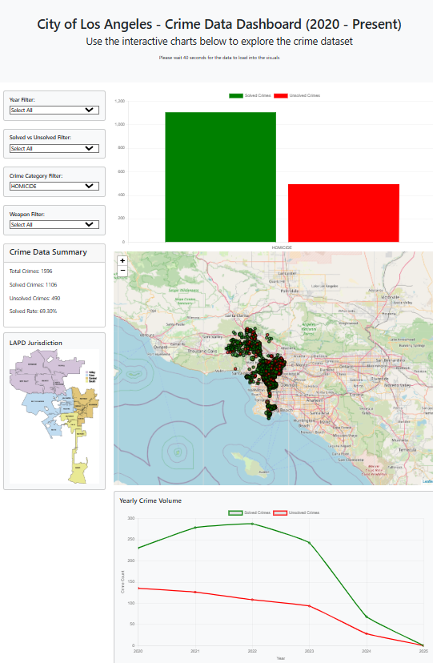
Crime Rate Analysis by Type & Location
Objective:
Understand how different crime types are distributed across Los Angeles neighborhoods.
Analysis Details:
Using filters to identify biggest impact on the areas with particular type of crime.

Slide 6
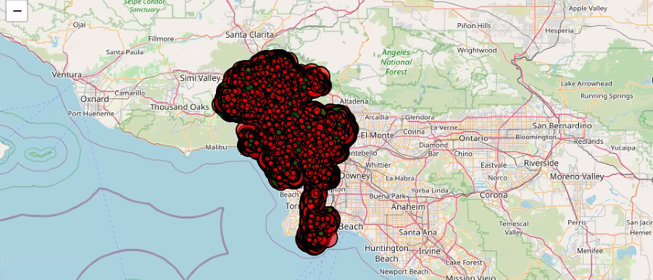
Crime Density Heat Map
Objective:
Visualize spatial clustering and identify crime hotspots.

Slide 7
Key Findings & Insights
Major Insights
High Crime Types: Identification of the most prevalent crime categories.
Spatial Trends: Notable hotspots in specific neighborhoods.
Temporal Shifts: Periods of significant increase/decrease in crime rates.

Slide 8

Implications for Stakeholders
For Law Enforcement:
Improved situational awareness and resource planning.
For Policy-Makers:
Informed decisions for community safety programs and policy development.
For the Community:
Enhanced transparency and engagement through accessible data insights.

Slide 9
Challenges & Future Directions
Project Challenges:
Data quality issues and missing geolocation details.
Integrating diverse data sources in real-time.
Future Enhancements:
Incorporate additional datasets (socio-economic factors, emergency responses).
Enhance interactivity and real-time analysis capabilities.
Expand to predictive analytics for proactive crime prevention.

Slide 10
Conclusion & Next Steps
Summary:
Comprehensive analysis of Los Angeles crime data (2020-Present)
highlighting key trends and hotspots.
Interactive visualizations providing actionable insights for stakeholders.
Next Steps:
Refine visualizations based on user feedback.
Explore deeper predictive analysis and integration with other data sources.

Slide 11

Q&A
Thank You!

